Slide 1


PREDICTIVE ANALYSIS OF ROAD ACCIDENT PREVENTION AND RESPONSE
Coapps- A Software Company
Project partner’s : College :
1.Azhagapan T (Team Lead). Kalaignarkarunanidhi
2.Sowmya K Institute of Technology.
3.Kaviya Sri K Coimbatore.

Slide 2
"If you want to
shine like a sun,
first
burn like a sun.“
-by Dr.APJ Abdul Kalam

Slide 3
Goal of our Project :
To predict and prevent the road accident by building a machine learning model with suitable algorithm.
Software Used :
1.Jupyter Notebook.
2.Vs-code.
3.Github.
4.Streamlit.

Slide 4
Agenda :
Data Cleaning.
Visualization.
Data Preprocessing.
Model Selection.
Accuracy.
Analysis.
Streamlit.

Slide 5
Data Cleaning :
i)Information of a dataset
Info() :
It gives the complete information about the dataset.
For example – Datatype, Count of null values etc…,
This dataset has no null values ,so there is no need is to change any NA value.

Slide 6
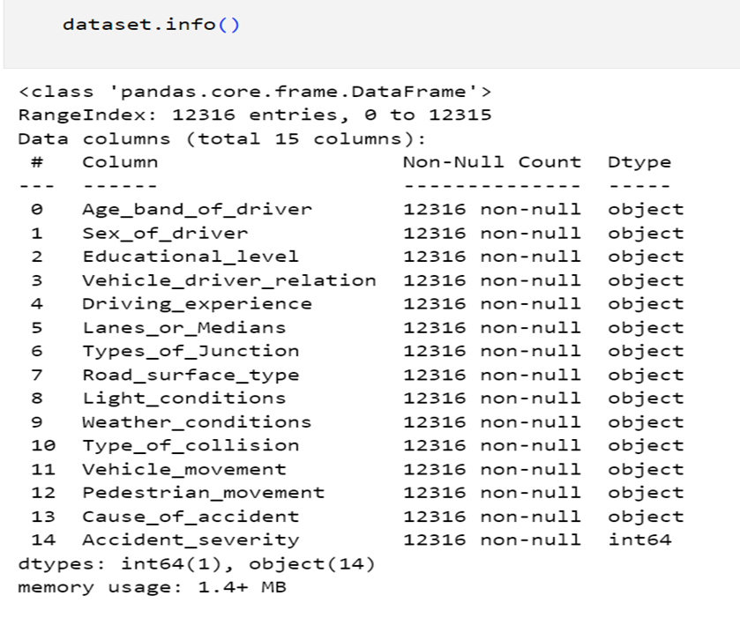
Code for getting info() :

Slide 7
ii) Droping unwanted columns:
This process is used to filter the wanted column that are required for modeling process.
Here the unwanted columns are –
1. Educational level.
2. Driver vehicle relation.
TARGET VARIABLE : Accident Severity

Slide 8
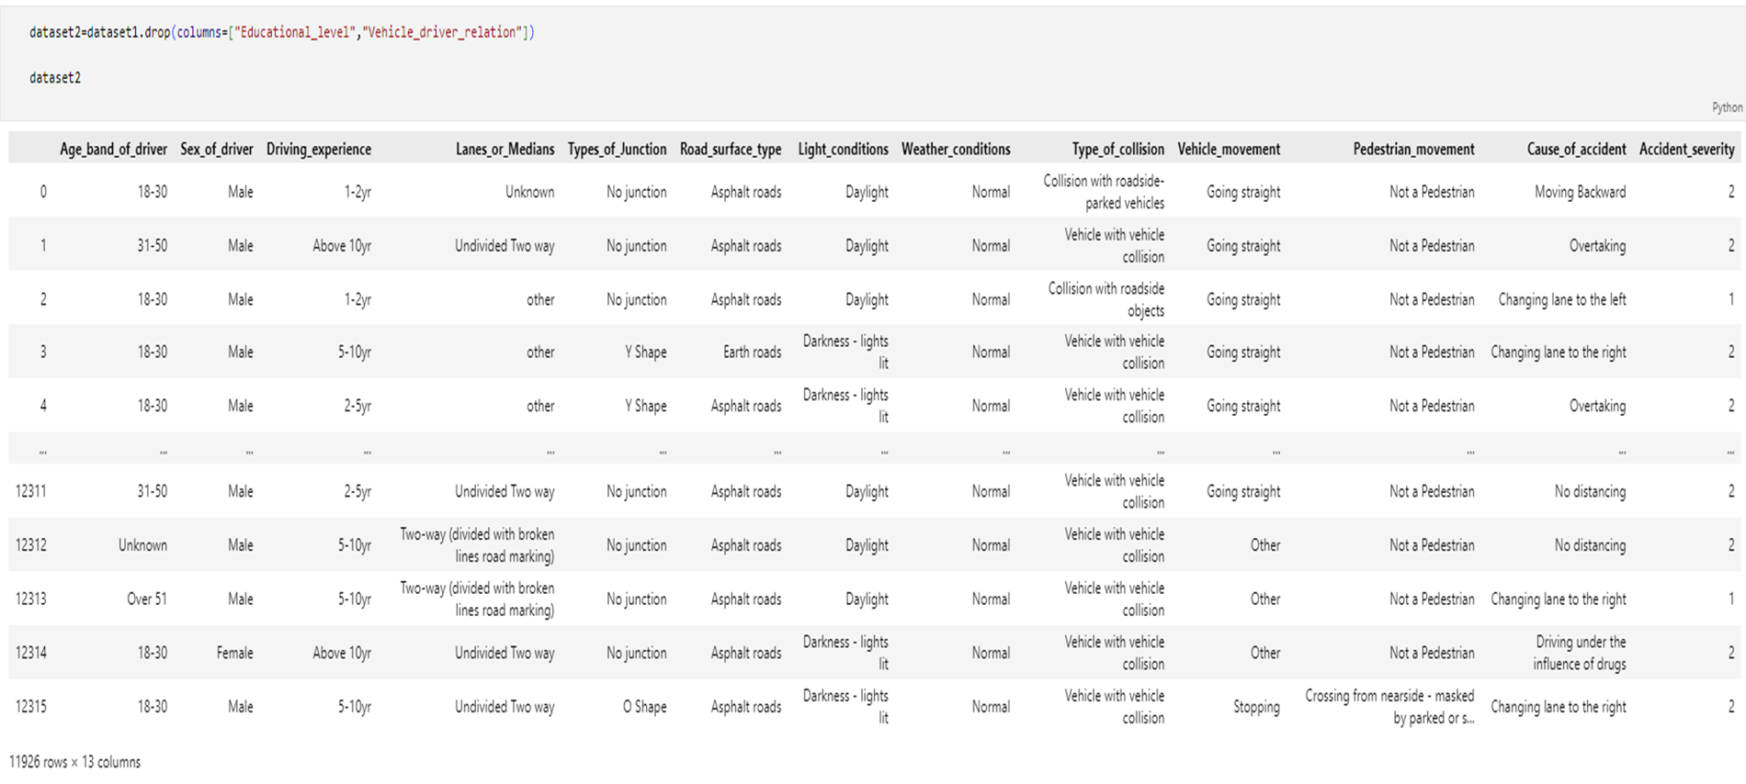
Code for removing column:

Slide 9
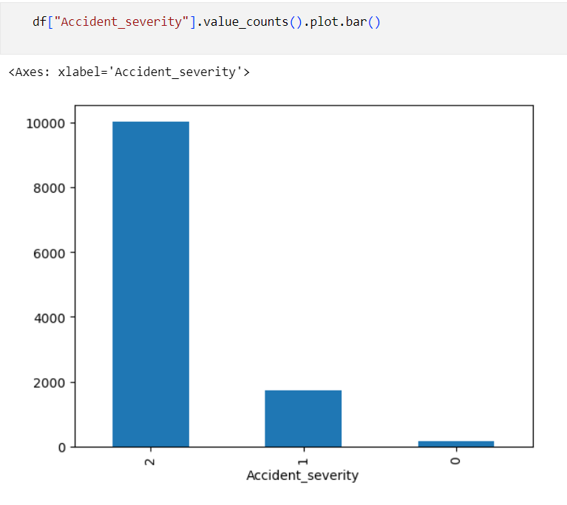
2. Visualization.
It’s the graphical representation of data or information.
i) Accident Severity :

Slide 10
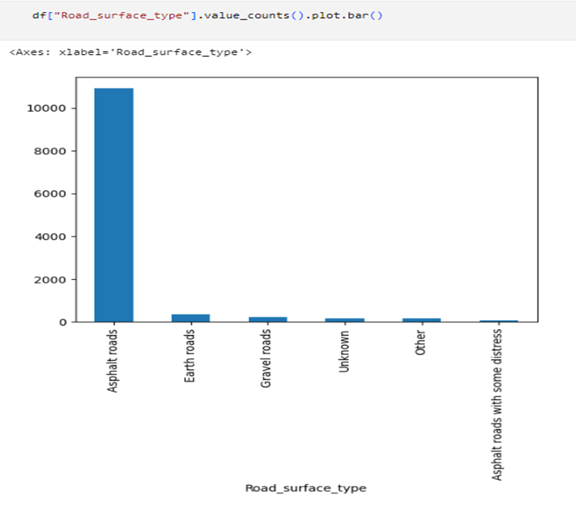
ii)Road surface type:

Slide 11
iii) Cause of the accident
The major reason for accident is due to :
1.No distancing. 2.Changing lane to right. 3.Changing lane to left. 4.Driving carelessly. 5.No priority to vehicle.

Slide 12
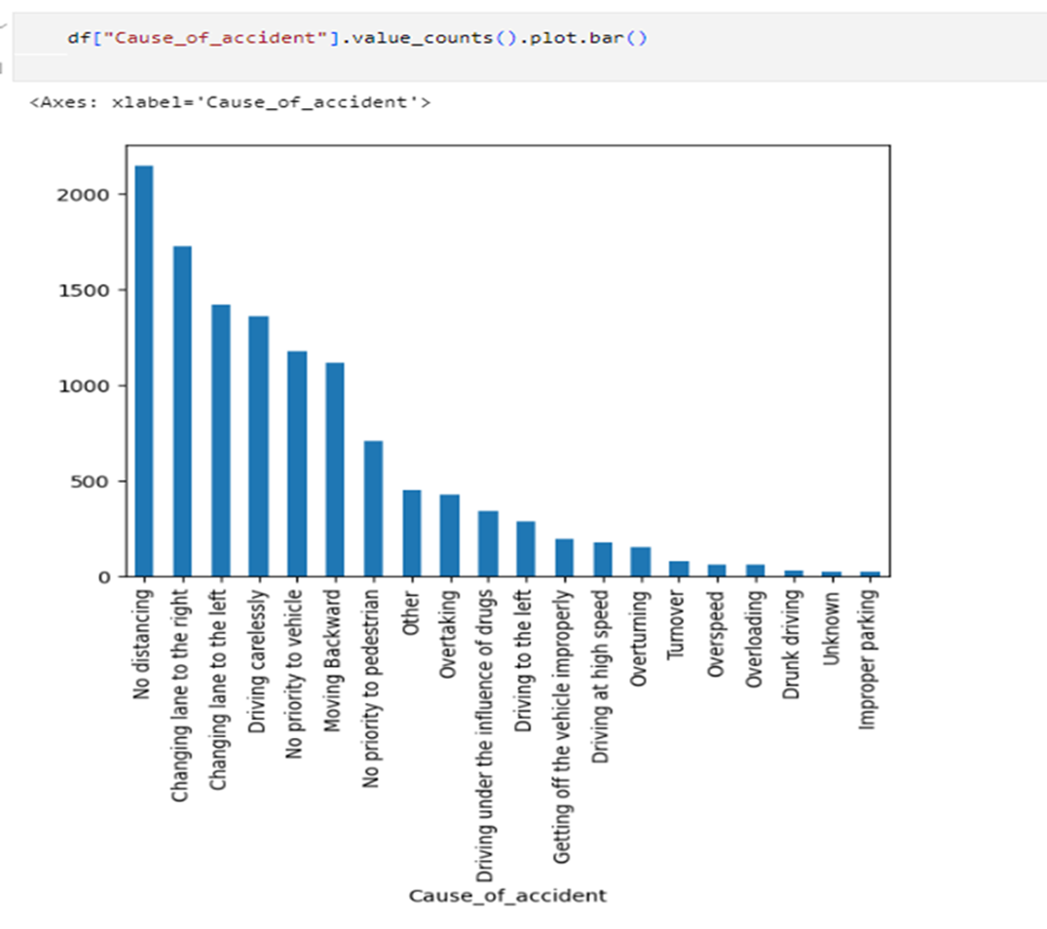
Cause of accident:

Slide 13
3.Data Preprocessing :
In this process , the data’s from the dataset are converted from categorical into numerical variable.
The method we use is Label Encoding.
1. Categorical – data’s in text format.
2. Numerical variable – data’s in integer form.

Slide 14
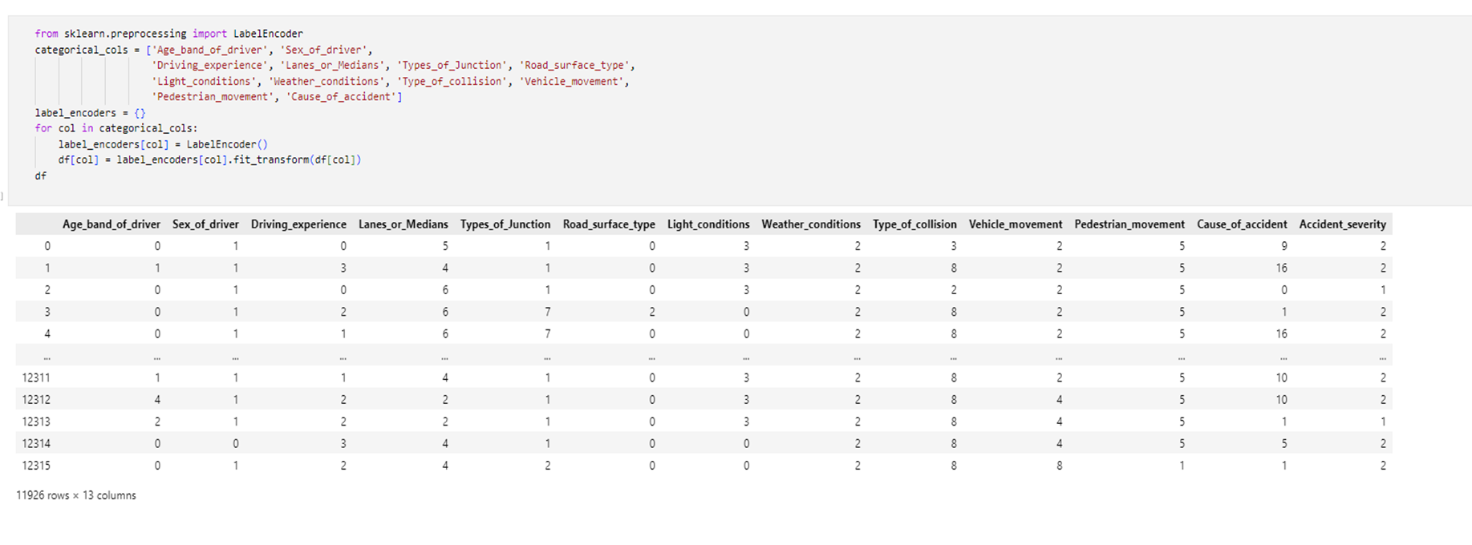
Code for Label Encoder:

Slide 15
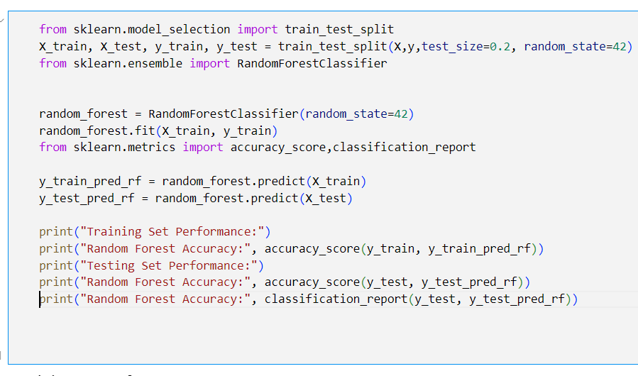
4.Model Selection: Random Forest Classifier

Slide 16
5.Accuracy:
Training Set Performance: Random Forest Accuracy-
0.9821802935010482[98%]
Testing Set Performance: Random Forest Accuracy-
0.8252305113160101[82%]

Slide 17
6.Analysis:
S.No. | Precision | Recall | f1-score | support
0 | 0.40 | 0.06 | 0.10 | 37
1 | 0.16 | 0.03 | 0.04 | 345
2 | 0.84 | 0.98 | 0.90 | 2007
Accuracy | - | - | 0.83 | 2386
Macro average | 0.47 | 0.35 | 0.35 | 2386
Weighted average | 0.74 | 0.83 | 0.77 | 2386

Slide 18
7.Streamlit:
We use streamlit to convert our project into interactive app by using PYTHON code.
To run this python code we use Visual Studio code .

Slide 19
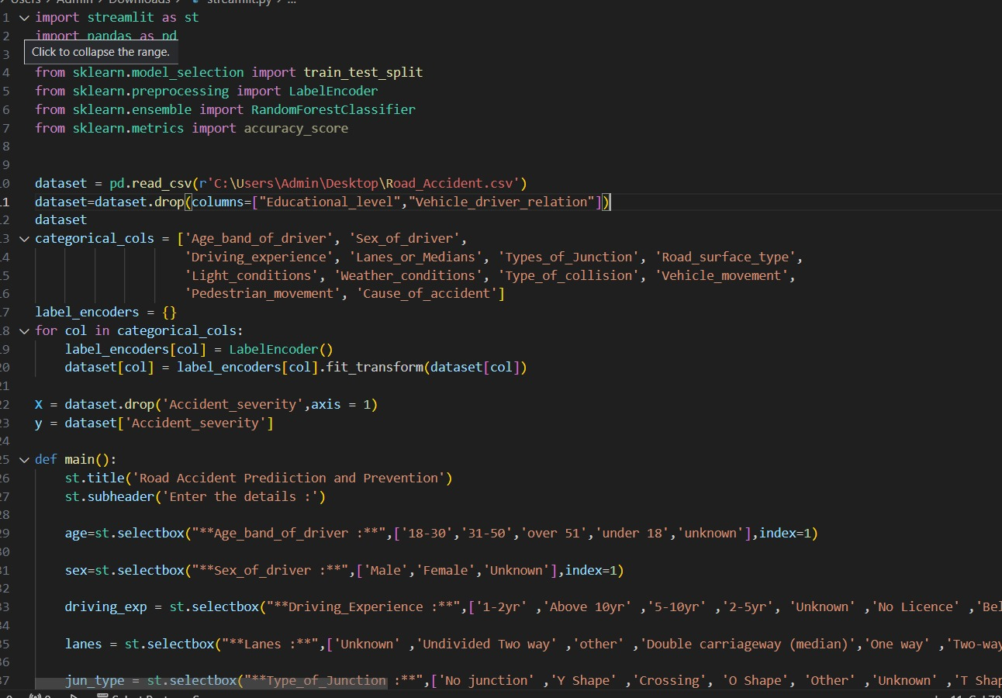
Code for Stream-lit:

Slide 20
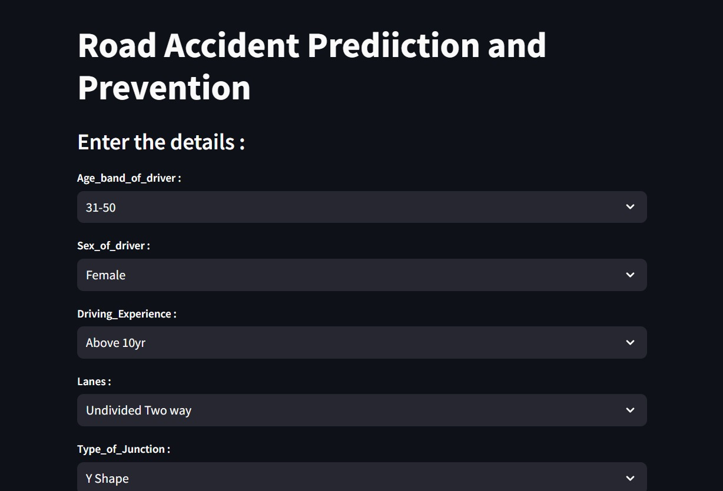

Slide 21
THANK YOU

